Slide 1

Facial Expression Recognition using CNN
NAME : Neelansh Pandey (1805210028)
Ritesh Kumar Chaurasia (1805210043)
Eshan Singh (1805210019)
BRANCH : C.S.E
Supervisor: Prof YN Singh
SEMESTER : VIII
Co-Supervisor: Ms. Deepali Awasthi

Slide 2
Table of Content
Introduction
Need and Purpose for FER
Methods of Facial Expression Recognition
Requirements for Creating Model
Process Model
Selection of Dataset
Image Data Preprocessing
Image Data Augmentation
Features Extraction and Training
Convolution Neural Network
Creating The CNN Model
Components of CNN Model
Validation and Output
Results
Conclusion
References

Slide 3
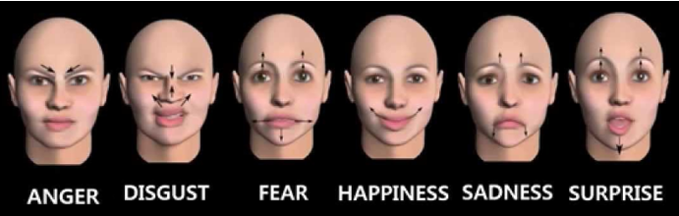
INTRODUCTION
Facial Expression recognition is the process of identifying human emotion using facial expressions. People vary widely in their accuracy at recognizing the emotions of others.
Facial expression recognition software is a technology which uses biometric markers to detect emotions in human faces. More precisely, this technology is a sentiment analysis tool and is able to automatically detect the six basic or universal expressions: happiness, sadness, anger, surprise, fear, and disgust.

Slide 4
Need and Purpose of FER
Facial Expression Recognition can play very vital in modern world technologies. It could prove to be very useful in todays and future technology. Some of them are as follows:
Human-Machine interaction: If we want human and Machines interact with each other it is necessary for a machine to know the current emotion of human from whom it is interacting. In this case FER becomes a necessity.
Interviews: FER can be very useful in analyzing the sentiments of the candidate when certain questions are asked and overall analysis of emotions during interview.
Other usages may be Advertisements, can be used by psychologist in diagnosis of Mental disorders, etc.

Slide 5
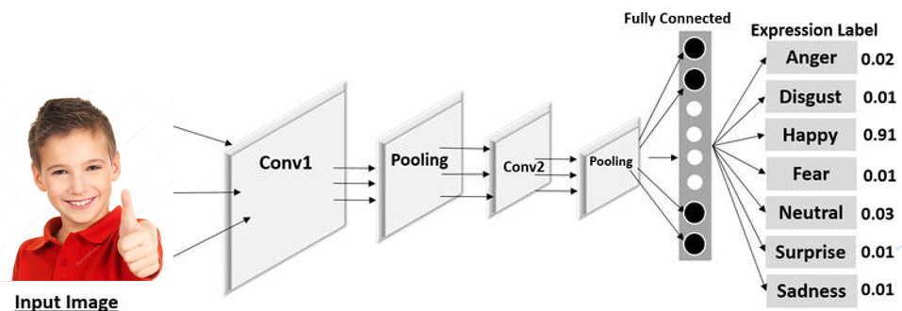
Methods for FER
Facial Expression Recognition can be done using Principal Component Analysis, Support Vector Machine and Convolution Neural Network (Artificial Neural Network Approach).
Accuracy of Convolution neural network is higher than any other methods and its easy to implement. So in this project we will be using Convolution neural network in order to achieve Facial Expression Recognition.

Slide 6





Requirements for Creating Model

Slide 7
Facial Expression Recognition Modules
Face Detection
Emotion Classification
Face Detection: Face Detection users Haar Cascade features with help of Haar cascade frontal face default file which is open source.
Emotion Classification: Emotion Classification will be done by training and testing a convolution neural network using dataset containing various emotions.

Slide 8
Process Model
Image Data Preprocessing
Image Data Augmentation
Feature Extraction and Training
Validation and Output
Depends on Accuracy
After selection of dataset steps in Facial Expression Recognition Using CNN
Image Data Preprocessing
Image Data Augmentation
Feature Extraction and Training
Validation and Output
If not satisfied with accuracy do hyper parameter tuning by adding hidden layer, changing learning rate, number of epochs, batch size, etc.

Slide 9
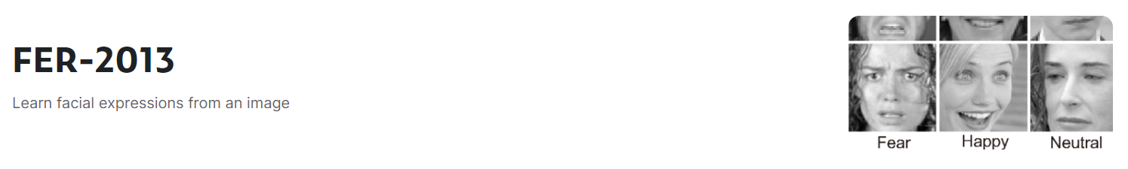
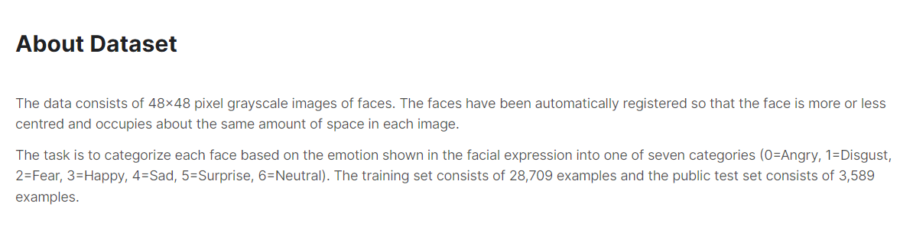
Selection of Dataset

Slide 10

Image Data Preprocessing
Image preprocessing are the steps taken to format images before they are used by model training and inference. This includes, but is not limited to, resizing, orienting, and color corrections. Preprocessing is required to clean image data for model input. Image preprocessing may also decrease model training time and increase model inference speed. Image Preprocessing can be done using OpenCV.
E.g. - Fully connected layers in convolutional neural networks required that all images are the same sized arrays which can be done by Image Preprocessing.

Slide 11
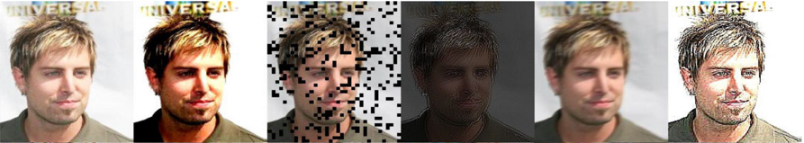
Image Data Augmentation
Image augmentation are manipulations applied to images to create different versions of similar content in order to expose the model to a wider array of training examples. For example, randomly altering rotation, brightness, or scale of input image requires that a model consider what an image subject looks like in a variety of situations.
Image augmentation creates new training examples out of existing training data. This is particularly important when collected datasets may be small. It is done using Image Data Generator.

Slide 12
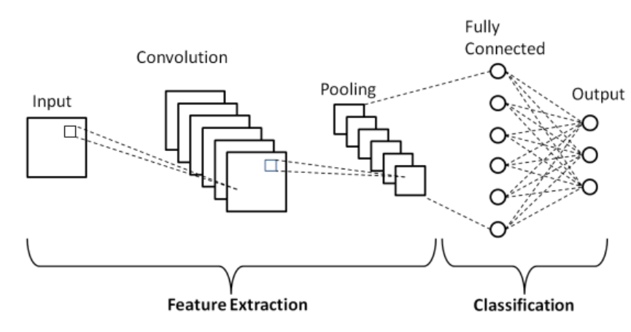
Feature Extraction and Training
Feature Extraction and Training will be done using Convolution Neural Network.
Convolution Neural Network (CNN)
A convolutional neural network (CNN) is a type of artificial neural network used in image recognition and processing that is specifically designed to process pixel data.
The convolution layers are used to help the computer determine features that could be missed in simply flattening an image into its pixel values.

Slide 13
Creating the CNN model:
Input
Layer 1
Layer 2
Layer 4
Layer 5
Output
Layer 3
FC Layer 2
FC Layer 1
Softmax
Creating the Convolutional Neural Network (CNN)
Input: The dataset we used in training of our Model.
Layer: Each layer contains Convolution layer, Batch Normalization layer, ReLU as Activation function,
Max pooling and dropout layer. Five such layers are used in the model.
FC layer: FC layer means Fully connected layer. Each of this layer uses a Fully connected neural network,
then a layer of Batch Normalization, ReLU as Activation function and dropout layer.
Softmax layer and Output: It contains Softmax as a Activation Function and for output seven neuron
representing each classes.

Slide 14
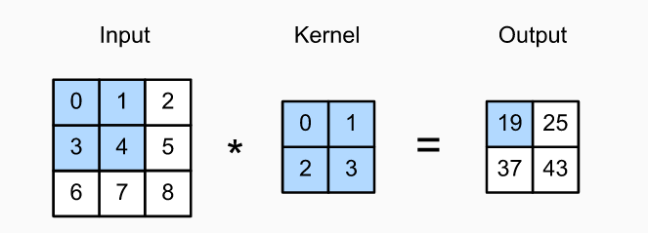
Components of the Model
Convolution 2D
Convolution is using a ‘kernel’ to extract certain ‘features’ from an input image. A kernel is a matrix, which is slid across the image and multiplied with the input such that the output is enhanced in a certain desirable manner.

Slide 15
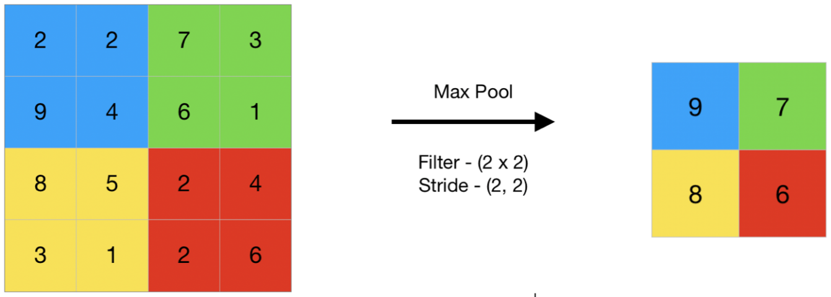
Max Pooling
Max Pooling is a pooling operation that calculates the maximum value for patches of a feature map, and uses it to create a down sampled (pooled) feature map. It is usually used after a convolutional layer.
Dropout
Dropout is a technique used to prevent a model from overfitting. Dropout works by randomly setting the outgoing edges of hidden units (neurons that make up hidden layers) to 0 at each update of the training phase.

Slide 16
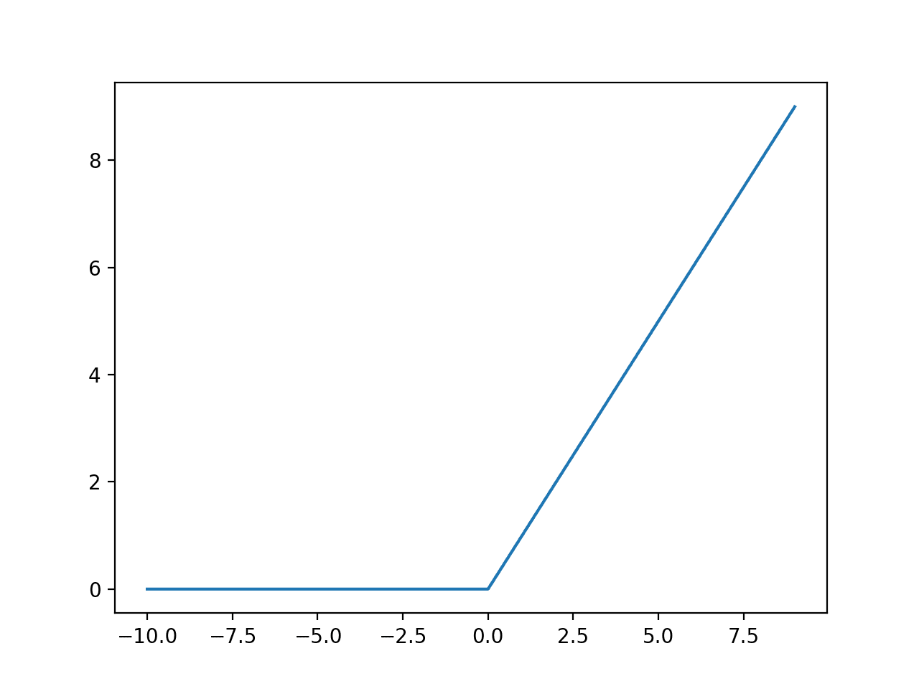
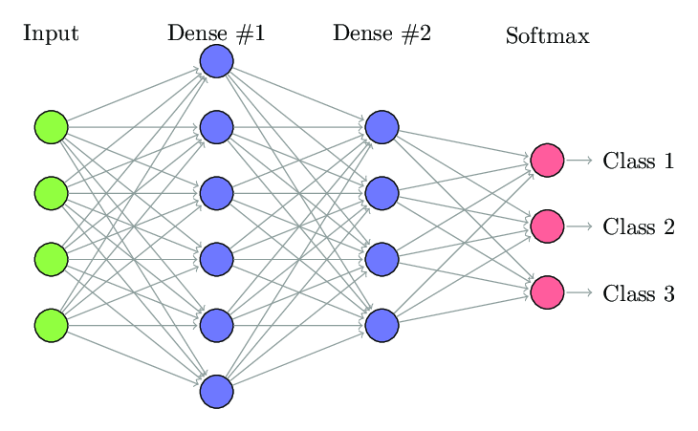
Activation Function (ReLU)
The rectified linear activation function or ReLU for short is a piecewise linear function that will output the input directly if it is positive, otherwise, it will output zero. It achieves better performance than most Activation Functions.
Fully Connected Neural Network
Array made from features of Images is flattened and passed through FCNN and
in this way neural network is trained further to produce output.

Slide 17
Validation and Output
In validation phase we check whether our model is providing accurate results.
In the case of less accurate result we again do feature extraction and training with some changes that can increase accuracy and even if accuracy is very low we will do changes in our dataset.
Validation and output phase can be executed with function in Keras and OpenCV.
In this phase we will also produce output. It will be done using webcam.
It will require Face detection and Facial Expression detection in order to produce
correct output.
Output will have following labels:
Neutral, Happiness, Sadness, Anger, Surprise, Fear, and Disgust.

Slide 18
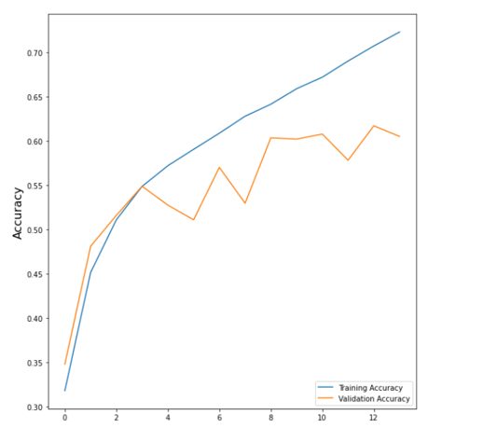
Results
Relationship between Accuracy and number of epochs

Slide 19
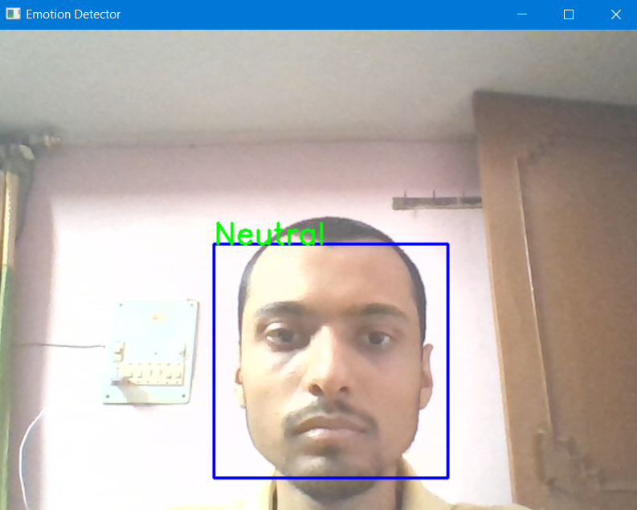
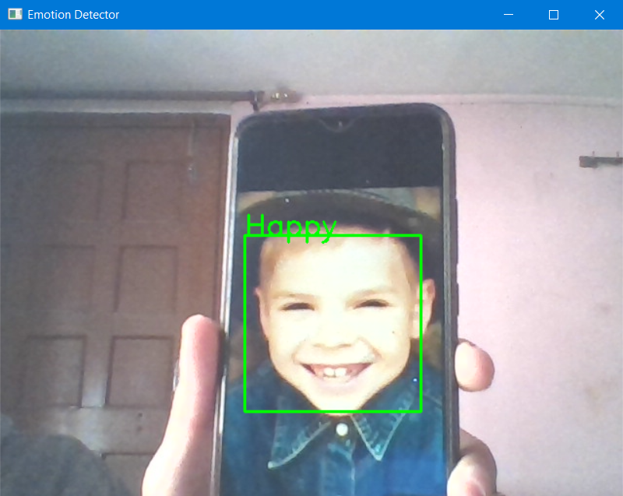
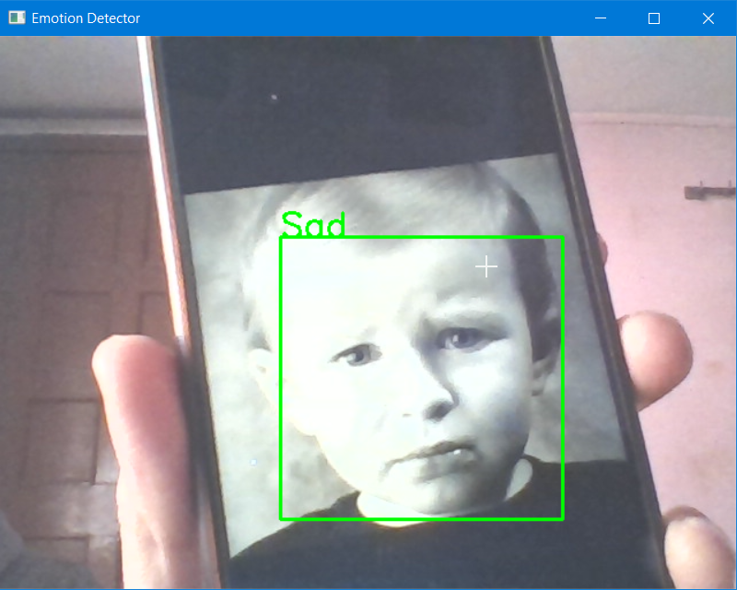
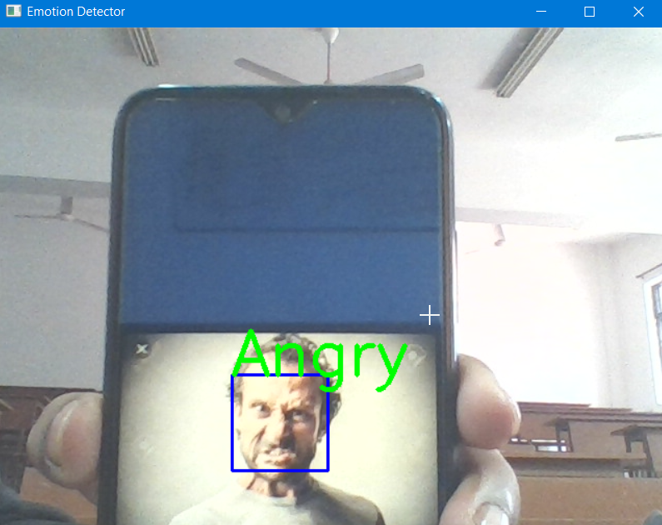
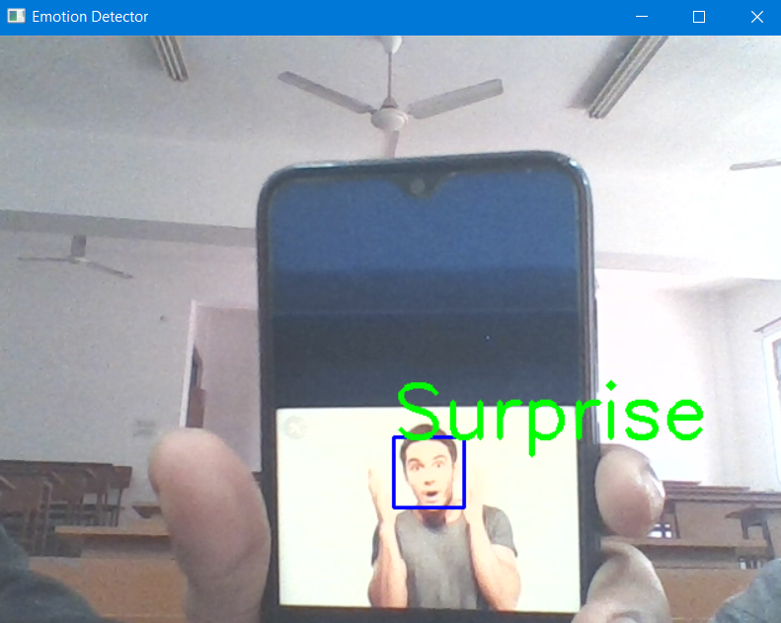
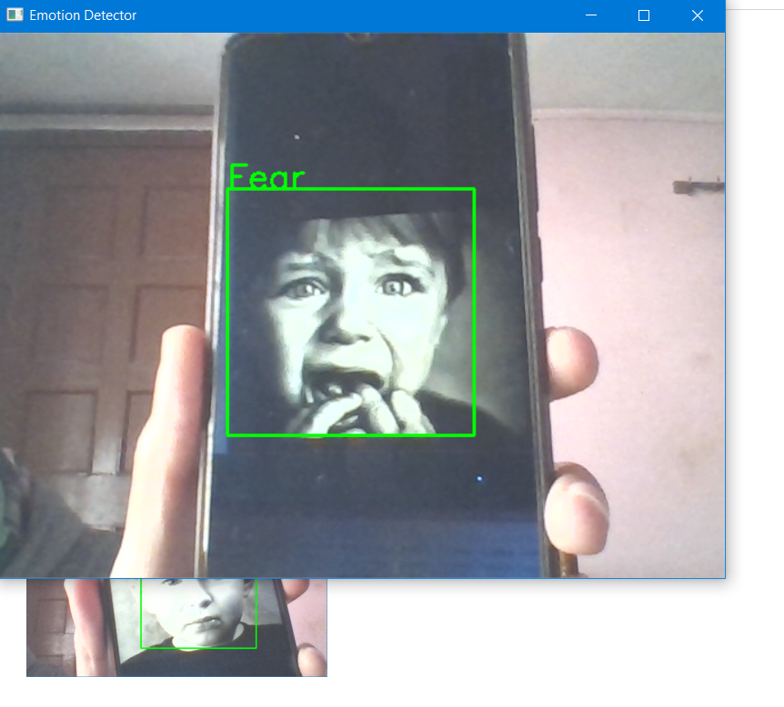

Slide 20
Conclusion
Objective of our project is Emotion Detection using Facial Expressions.
Method used for implementing is Convolution Neural Network (CNN)
3) Steps in Facial Expression Recognition Using CNN
Image Data Preprocessing
Image Data Augmentation
Feature Extraction and Training
Validation and Output
4) Image Data Preprocessing and augmentation will be done using functions present in OpenCV and Tensorflow.
5) Feature Extraction and Training will be done using CNN with the help of Keras and Tensorflow.
6) Validation and Output phase can be done using OpenCV and Keras
7) Training accuracy is 72% and Validation accuracy is 62%.

Slide 21
References
[1] Syed Inthiyaz et al 2021 J. Phys.: Conf. Ser. 1804 012202, “Facial Expression Recognition Using KERAS”,
accessed 9 April 2021
<https://iopscience.iop.org/article/10.1088/1742-6596/1804/1/012202>
[2] William Pao, a&s International, “The many application of emotion recognition”, accessed 12 Oct 2017
<https://www.asmag.com/showpost/23883.aspx>
[3] Sumit Saha, “A Comprehensive Guide to Convolutional Neural Networks”, accessed 15 December 2018
<https://towardsdatascience.com/a-comprehensive-guide-to-convolutional-neural-networks-the-eli5-way-3bd2b1164a53>
[4] Joseph Nelson, “Why Image Preprocessing and Augmentation Matter”, accessed 26 Jan 2020.
<https://blog.roboflow.com/why-preprocess-augment/>
[5] K. Shan, J. Guo, W. You, D. Lu and R. Bie,
"Automatic facial expression recognition based on a deep convolutional-neural-network structure,"
2017 IEEE 15th International Conference on Software Engineering Research, Management and Applications (SERA),
2017, pp. 123-128, doi: 10.1109/SERA.2017.7965717.

Slide 22
Thank You!!

